Slide 1
DATA STRUCTURES (CS3401)
Dr. Somaraju Suvvari,
Asst. Prof, Dept. of CSE, NIT Patna.
somaraju@nitp.ac.in; soma2402@gmail.com;

Slide 2
The Course
DATA STRUCTURES

Slide 3
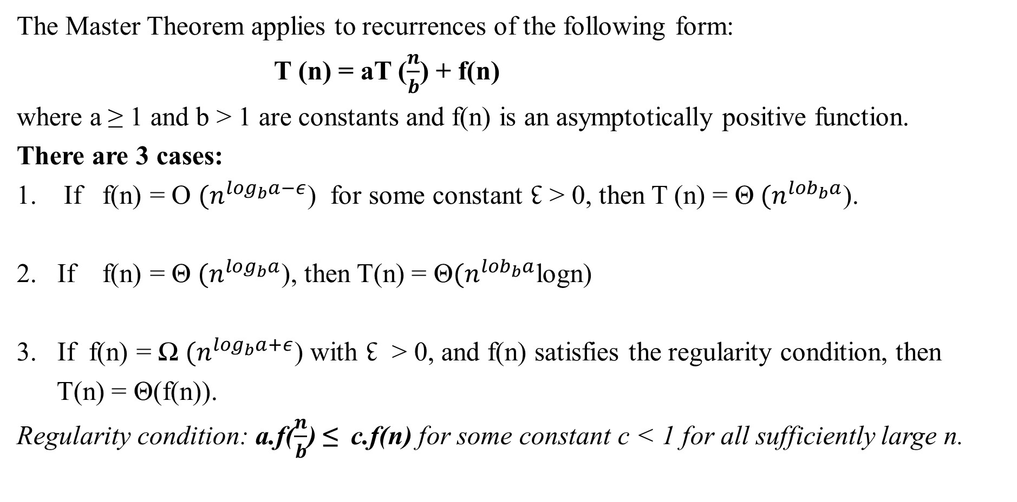
Master Theorem
The Master Theorem applies to recurrences of the following form:
T (n) = aT ($\frac{n}{b}$) + f(n)
where a ≥ 1 and b > 1 are constants and f(n) is an asymptotically positive function.
There are 3 cases:
If f(n) = O ${(n}^{\log_{b}a−ε}$) for some constant ↋ > 0, then T (n) = Θ ${(n}^{{lob}_{b}a}$).
If f(n) = Θ ${(n}^{\log_{b}a}$), then T(n) = Θ${(n}^{{lob}_{b}a}$logn)
If f(n) = Ω ${(n}^{\log_{b}a+ε}$) with ↋ > 0, and f(n) satisfies the regularity condition, then
T(n) = Θ(f(n)).
Regularity condition: a.f($\frac{n}{b}$) ≤ c.f(n) for some constant c < 1 for all sufficiently large n.

Slide 4
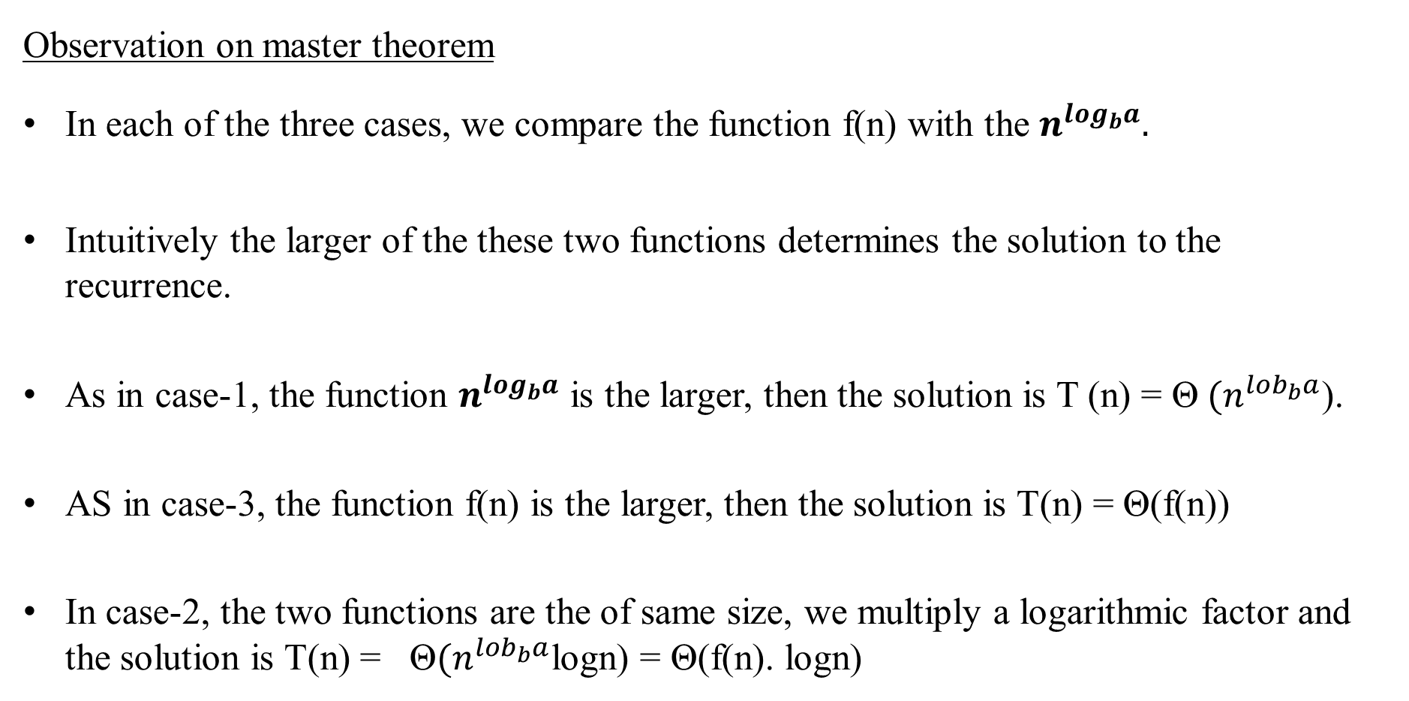
Master Theorem
Observation on master theorem
In each of the three cases, we compare the function f(n) with the $n^{\log_{b}a}.$
Intuitively the larger of the these two functions determines the solution to the recurrence.
As in case-1, the function $n^{\log_{b}a}$ is the larger, then the solution is T (n) = Θ ${(n}^{{lob}_{b}a}$).
AS in case-3, the function f(n) is the larger, then the solution is T(n) = Θ(f(n))
In case-2, the two functions are the of same size, we multiply a logarithmic factor and the solution is T(n) = Θ${(n}^{{lob}_{b}a}$logn) = Θ(f(n). logn)

Slide 5
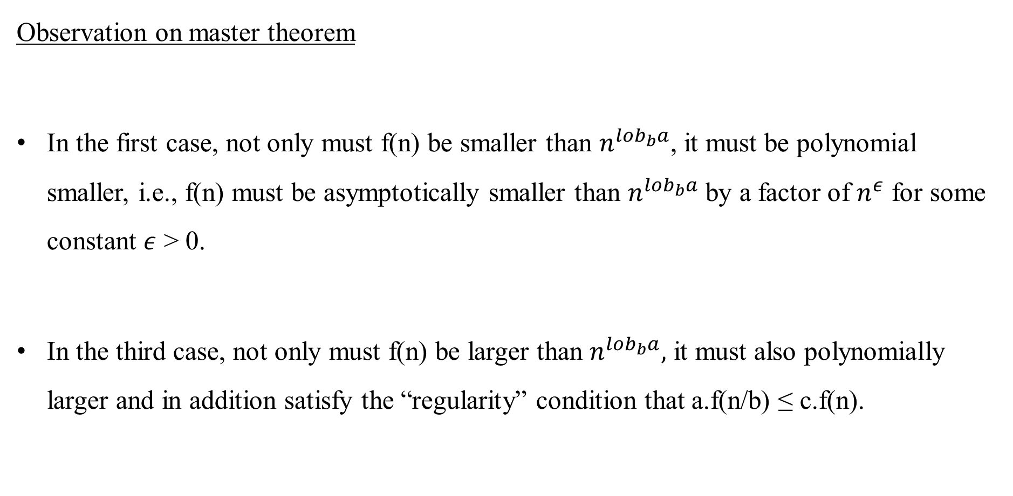
Master Theorem
Observation on master theorem
In the first case, not only must f(n) be smaller than $n^{{lob}_{b}a}$, it must be polynomial smaller, i.e., f(n) must be asymptotically smaller than $n^{{lob}_{b}a}$ by a factor of $n^{ε}$ for some constant $ε$ > 0.
In the third case, not only must f(n) be larger than $n^{{lob}_{b}a},$ it must also polynomially larger and in addition satisfy the “regularity” condition that a.f(n/b) ≤ c.f(n).

Slide 6
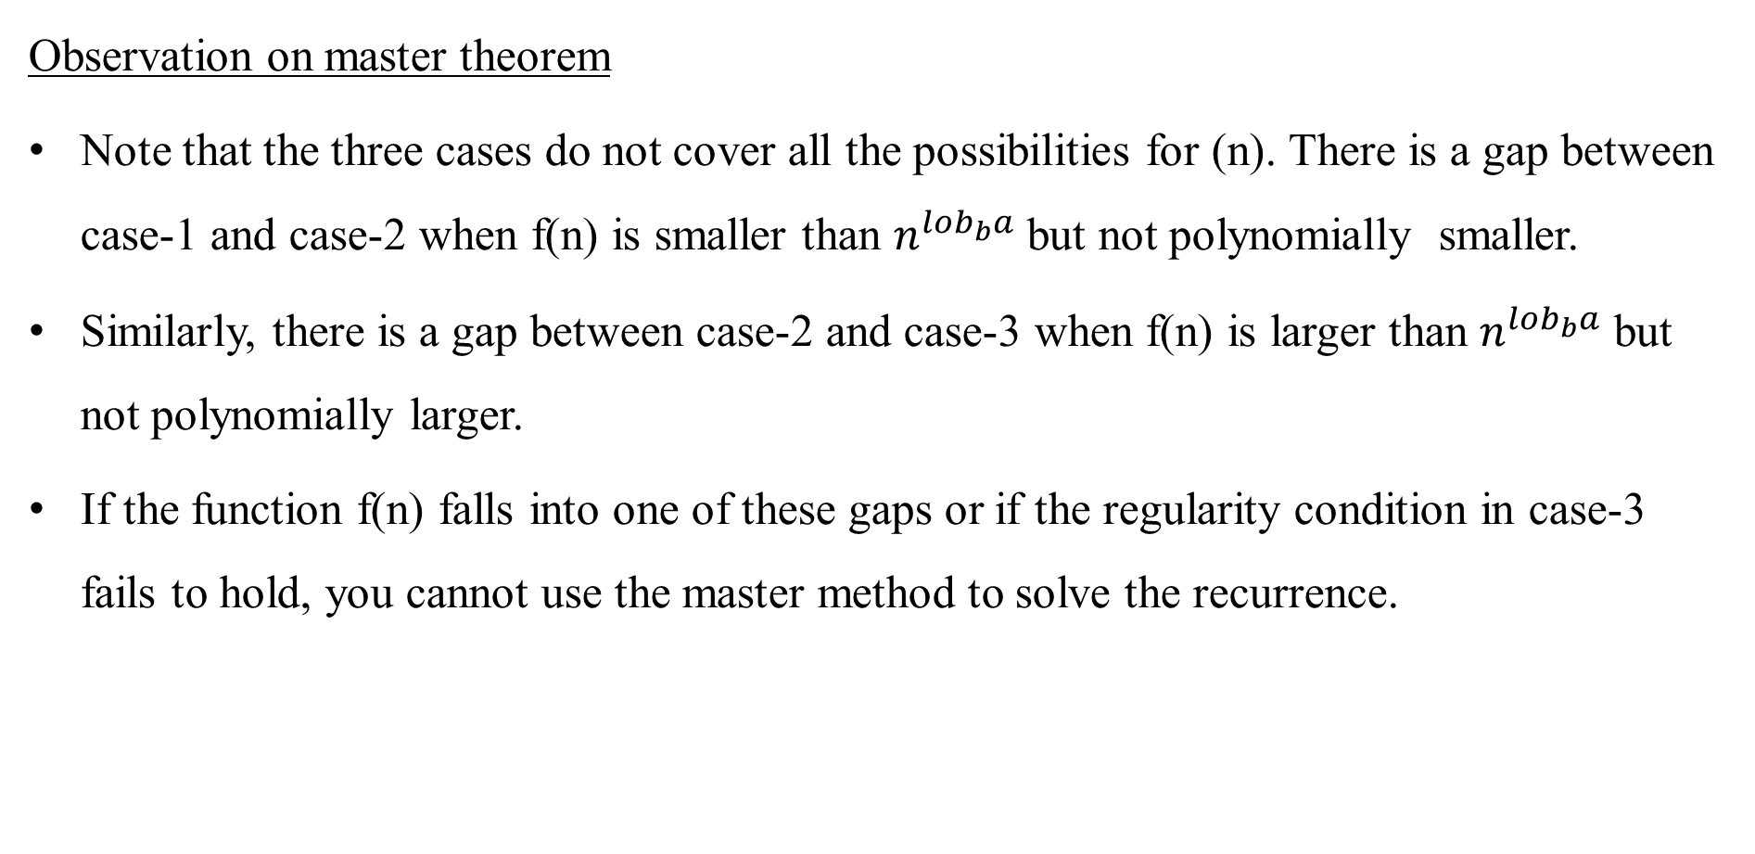
Master Theorem
Observation on master theorem
Note that the three cases do not cover all the possibilities for (n). There is a gap between case-1 and case-2 when f(n) is smaller than $n^{{lob}_{b}a}$ but not polynomially smaller.
Similarly, there is a gap between case-2 and case-3 when f(n) is larger than $n^{{lob}_{b}a}$ but not polynomially larger.
If the function f(n) falls into one of these gaps or if the regularity condition in case-3 fails to hold, you cannot use the master method to solve the recurrence.

Slide 7

Master Theorem (Examples)
T(n) = 3T(n/2) + n²
Solution:
f(n) = n² a = 3, b=2, $n^{\log_{b}a} =n^{\log_{2}3}$
Case-3
T(n) = Θ(n²)
2. T(n) = 4T(n/2) + n²
Solution:
a=4, b=2, $n^{\log_{b}a} =n^{\log_{2}4}$ = n²
Case-2
T(n) = Θ(n² log n)

Slide 8
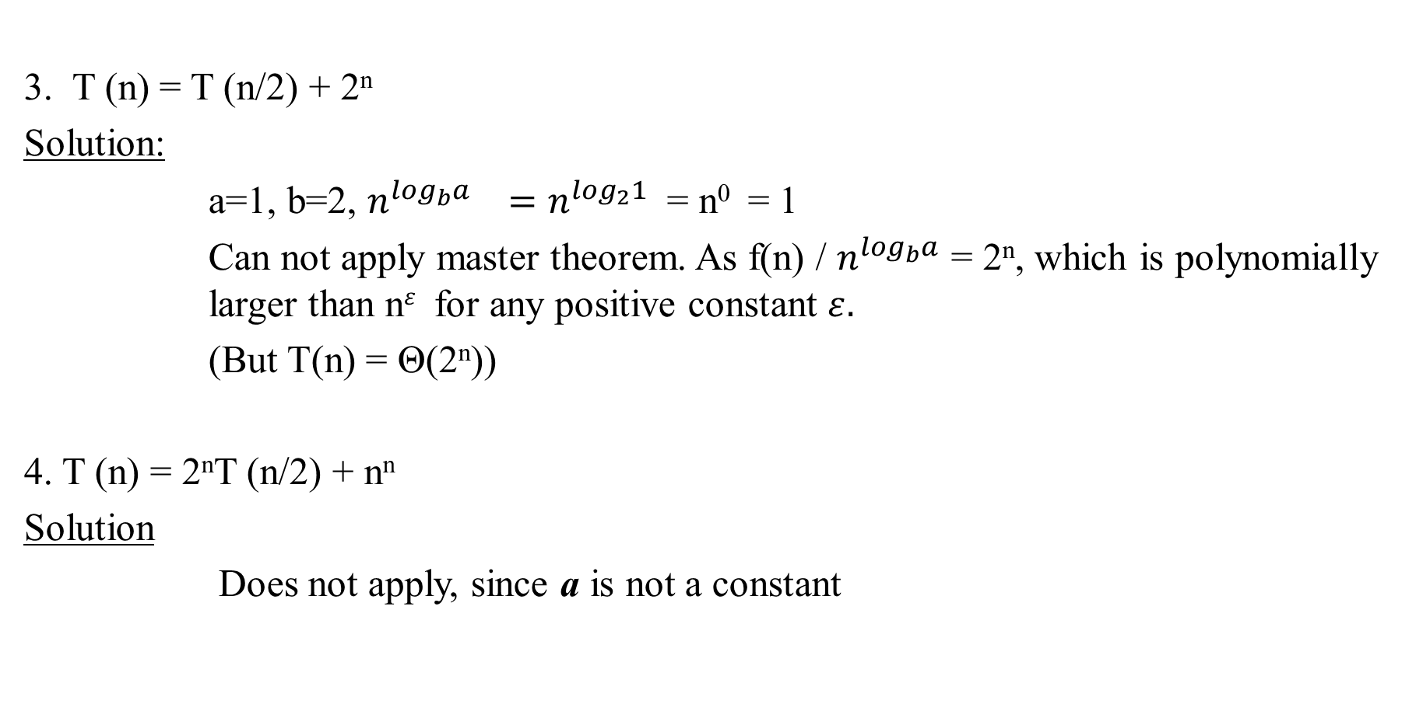
Master Theorem (Examples)
3. T (n) = T (n/2) + 2^{n}
Solution:
a=1, b=2, $n^{\log_{b}a} =n^{\log_{2}1}$ = n⁰ = 1
Can not apply master theorem. As f(n) / $n^{\log_{b}a}$ = 2^{n}, which is polynomially larger than n$ε$ for any positive constant $ε.$
(But T(n) = Θ(2^{n}))
4. T (n) = 2^{n}T (n/2) + n^{n}
Solution
Does not apply, since a is not a constant

Slide 9

Master Theorem (Examples)
5. T (n) = 64T (n/8) − n² log n
Solution
Does not apply, since f(n) is not positive
T (n) = 16T (n/4) + n
Solution
a=16, b= 4, $n^{\log_{b}a} =n^{\log_{4}16}$ = n²
case-1, $ε$ = 1.
T(n) = Θ(n²)

Slide 10

Master Theorem (Examples)
7. T(n) = T(2n/3) + 1
case -2, so T(n) = Θ(logn)
8. T(n) = 3T(n/4) + nlogn
a =3, b= 4, f(n) = n logn, and $n^{\log_{b}a} =n^{\log_{4}3}$ = n^{0.793}
f(n) = Ω ${(n}^{\log_{4}3+ε}$), where ↋ $≈$ 0.2.
case-3.
Regularity condition: a.f($\frac{n}{b}$) = 3(n/4)log(n/4) ≤ 3/4.n logn = cf(n) for c=3/4
T(n) = Θ(n logn)

Slide 11
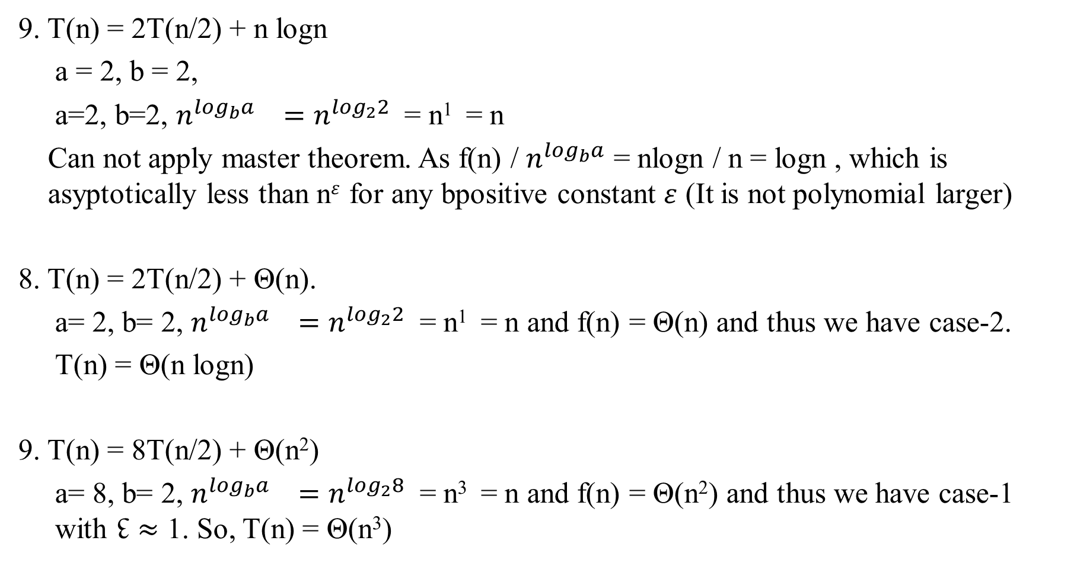
Master Theorem (Examples)
9. T(n) = 2T(n/2) + n logn
a = 2, b = 2,
a=2, b=2, $n^{\log_{b}a} =n^{\log_{2}2}$ = n¹ = n
Can not apply master theorem. As f(n) / $n^{\log_{b}a}$ = nlogn / n = logn , which is asyptotically less than n$ε$ for any bpositive constant $ε$ (It is not polynomial larger)
8. T(n) = 2T(n/2) + Θ(n).
a= 2, b= 2, $n^{\log_{b}a} =n^{\log_{2}2}$ = n¹ = n and f(n) = Θ(n) and thus we have case-2.
T(n) = Θ(n logn)
9. T(n) = 8T(n/2) + Θ(n²)
a= 8, b= 2, $n^{\log_{b}a} =n^{\log_{2}8}$ = n³ = n and f(n) = Θ(n²) and thus we have case-1 with ↋ $≈$ 1. So, T(n) = Θ(n³)

Slide 12

Master Theorem (Examples)
9. T(n) = 7T(n/2) + Θ(n²)
a= 7, b= 2, $n^{\log_{b}a} =n^{\log_{2}7}$ = n^{2.81} and f(n) = Θ(n²) and thus we have case-1 with ↋ $≈$ 0.8. So, T(n) = Θ($n^{\log_{2}7}$).

Slide 13
Numerical Comparison of Different Algorithms

Slide 14
Comparison of Different Algorithms

Slide 15
Nested Loops
M=10,N=10;
for(i=1; i<=M;i++)
for(j=1;j<=N;j=j*2)
printf(“hai”);
M=10,N=5;
for(i=0; i<M;i++)
for(j=0;j<N;j++)
printf(“hai”);
Inner loop is executed N times when i=0,
Inner loop will be executed M times i=0 to M.
Outer loop is executed M times,
Hence the time complexity is M*N.
Inner loop is executed log(N) times when i=1,
Inner loop will be executed M times i=1 to M.
Hence the time complexity is M*log(N).
M=10,;
for(i=0; i<M;i++)
for(j=0;j<=i; j++)
printf(“hai”);
i=0, j=0 1-time
i=1, j=0,1 2-times
i=2, j=0,1,2 3-times
……………….. …………
……………….. …………
i=9, j=0,1, …, 9 10-times
------------
55 times
------------
M(M+1)/2
Time Complexity is (M²)-Quadratic
M=10,;
for(i=0; i<M;i++)
for(j=0;j<M;j++)
printf(“hai”);
Time Complexity is (M²)-Quadratic

Slide 16
Big-Oh Examples
int searchK(int arr[], int n, int k)
{// for-loop to iterate with each element in the array
for (int i = 0; i < n; ++i)
{ // check if ith element is equal to "k" or not
if (arr[i] == k)
return 1; // return 1, if you find "k"
} return 0; // return 0, if you didn't find "k"
}
T(n)=3n+4
f(n)=n,
T(n) = c * f(n)
3n+4 <= cn
What is c?
What is n?
n>=2, c=5
n=2, 3*2+4 < =5*2
n=3, 3*3+4 <5*3 => 13< 15.
* i = 0 ------------> 1
* i < n ------------> n+1 times
* i++ --------------> n times
* if(arr[i] == k) --> n times
* return 1 ---------> 1(if "k" is there in the array)
* return 0 ---------> 1(if "k" is not there in the array)
------------
3n+4
------------
Time complexity is O(n)

Slide 17
Thank You

